Slide 1
A.S.D.GOVERNMENT DEGREE COLLEGE FOR WOMEN (AUTONOMOUS) KAKINADA
DEPARTMENT OF MICROBIOLOGY
General Principles of Diagnostic Microbiology (Laboratory Diagnosis)
Collection and Transport of Specimen
II BSc CBMB SEM IV
BY
Dr. K. Aruna
Lecturer in Microbiology

Slide 2
General Principles of Diagnostic Microbiology
1. Collection of Sample
2. Handling of collected Sample
3. Transport
4. General methods for Laboratory Diagnosis

Slide 3
Collection and Transport of Specimen
Successful Laboratory Investigations
The specimen should selected adequately represents the diseased area additional areas (live and blood stream)
Collection of adequate and appropriate specimen
Avoid the contamination
If possible specimen should obtained before antimicrobial administerd
Biosafety and decontamination & Sufficient documentation
Correct packing and rapid transport
The specimen should be forwarded promptly to the Clinical laboratory
Timely communication of Results
Common Specimens
Swabs (Throat, Nasal, Eye, Ear and Cervical)
CSF
Blood
pus
Urine
Sputum
Stool

Slide 4
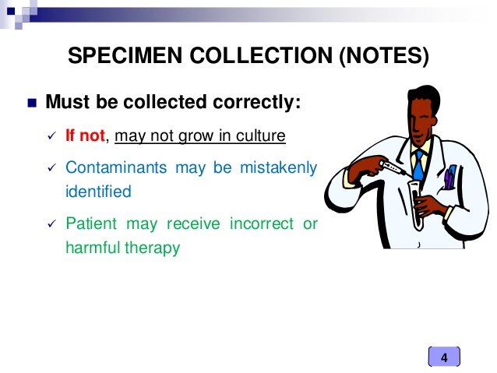

Slide 5
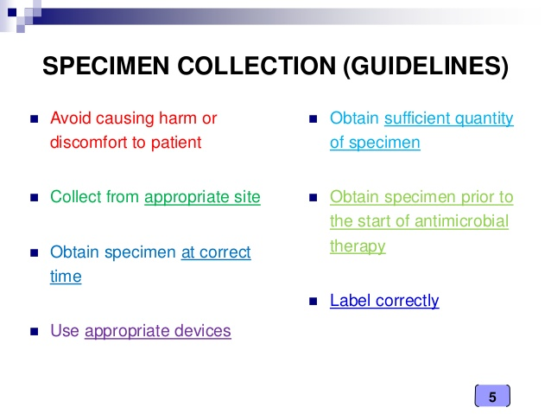
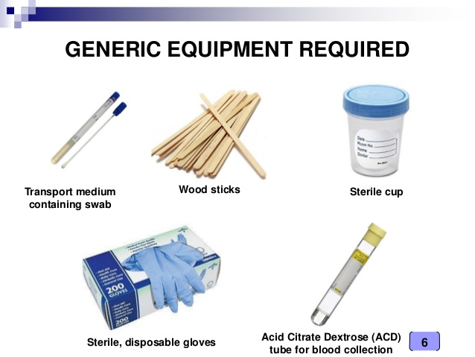
Collection and Transport of Specimen

Slide 6
Methods Used to Collect the Samples
Swab
Need Aspiration
Intubation
Catheter
Clean-Catch Method
Sputum -Cup Method

Slide 7
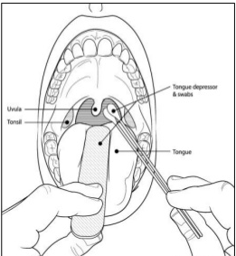
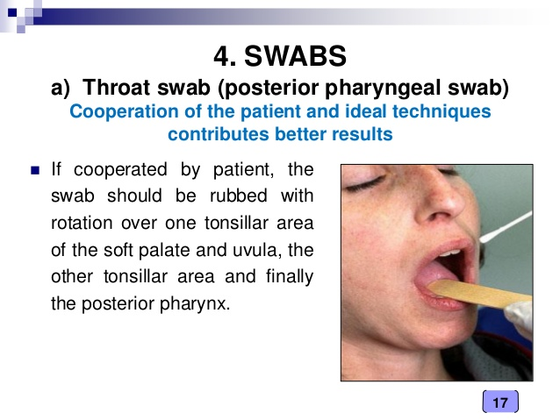
Swab
Swab is the most common method used to collect specimen from the anterior nares or throat. A sterile swab is a rayon- calcium alginate or Dacron-tipped polysttryene applicator. Many of having transport media to preserve a Varity of microorganisms.
Throat swab
A plain cotton wool swab should be used to collect as much as exudates as possible from tonsils, posterior pharyngeal wall.
Throat swab (Posterior Pharyngeal Swab)

Slide 8
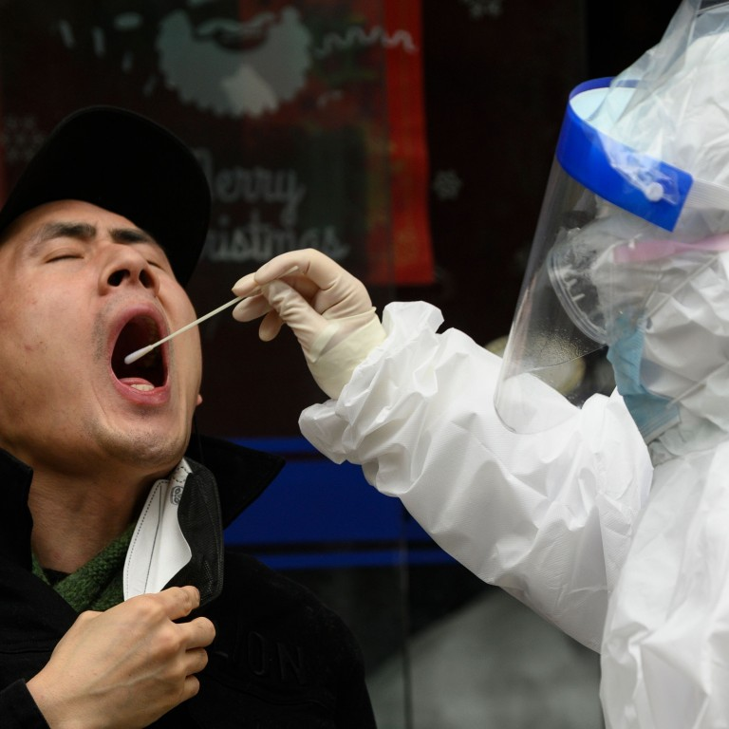
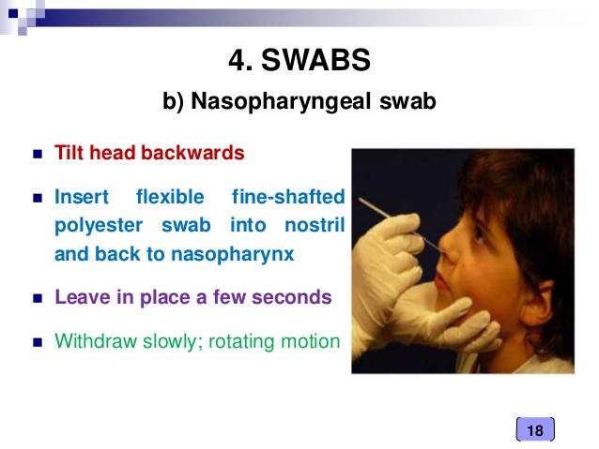
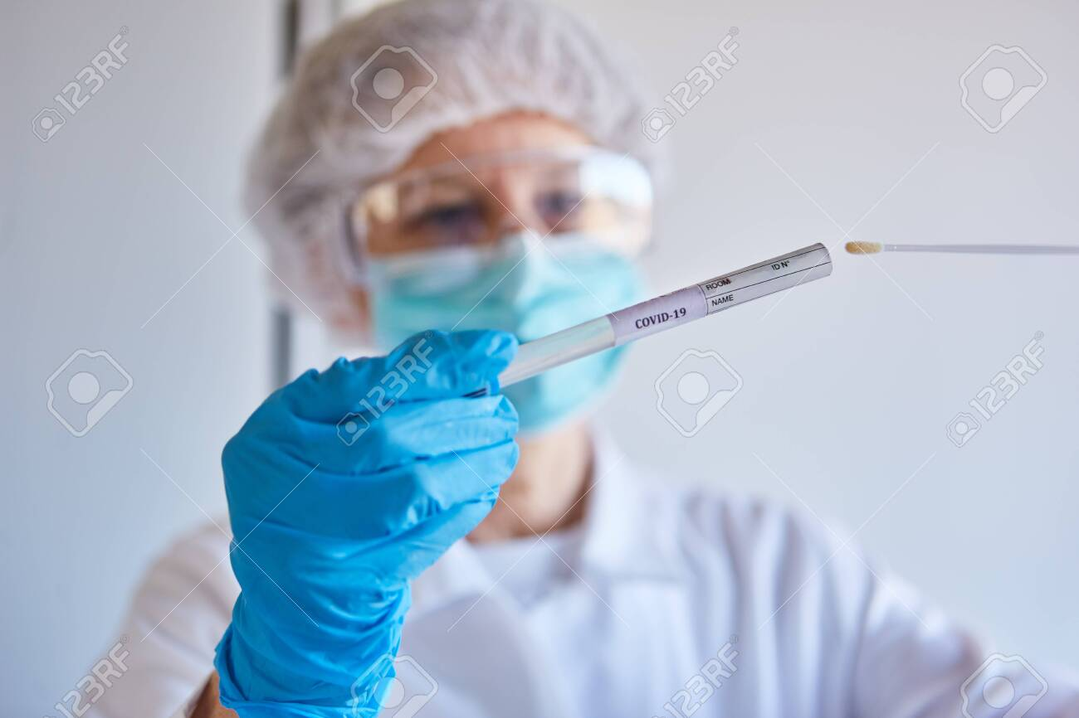
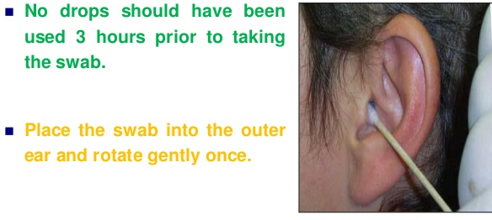
Saliva sample as a swab of throat for Covid-19 laboratory test during Coronavirus epidemic
Naso Pharyngeal Swab
EarSwab

Slide 9
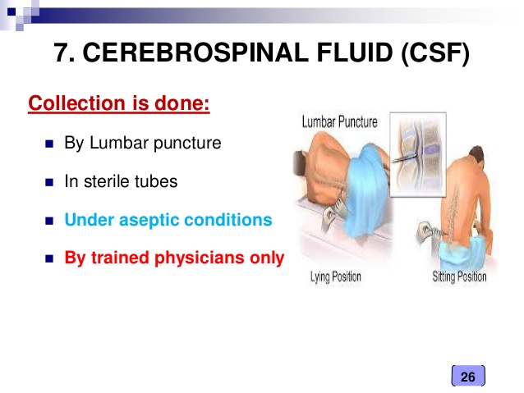
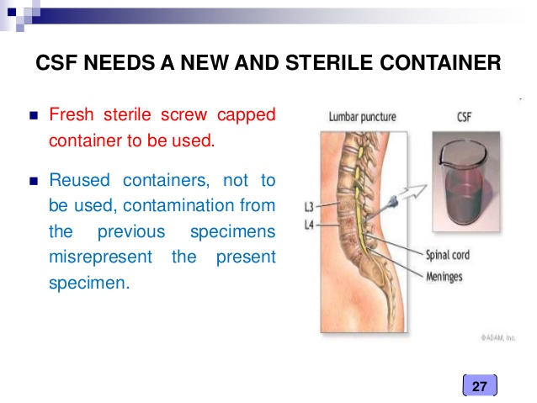
Needle Aspiration
Needle Aspiration is used to collect he specimens aseptically from Cerebrospinal fluid, Pus and Blood.
Cerebrospinal fluid

Slide 10
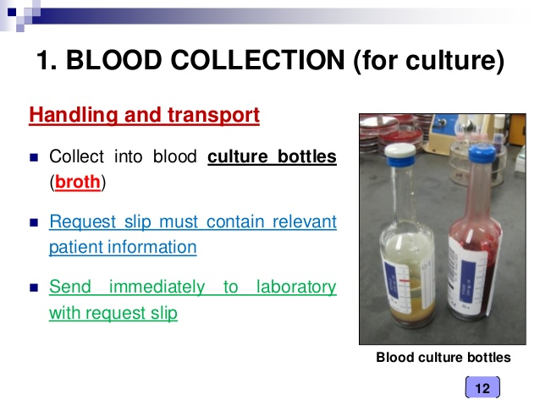
Blood Collection (for culture)
Automated blood culture systems are the primary choice for the detection of pathogens from blood specimens.
Instead of manually read broth-based conventional methods, laboratories use continuously monitored, automated blood culture systems for the processing of blood culture specimens nowadays.
Bactec Culture vials Depending on the type of suspected pathogen, several broth formulas are available, including media for the recovery of aerobic and anaerobic bacteria, mycobacteria, and fungi. No single type is optimal for all microorganisms.
Handling and Transport
Collect into blood Culture bottles(Broth)
Require slip must contain relevant Patient Information
Send immediately to laboratory with request slip

Slide 11
Pus-Specimen Collection
The ideal specimen is an aspirate from a previously undrained abscess, or a tissue biopsy.
Ideally, a minimum volume of 1mL (up to 5 mL) of pus should be collected.
The aspirate should be collected in a sterile syringe – any air bubbles should be expelled.
Needle safely and tightly capped (needles should NOT be sent).
A tissue specimen should be placed in a sterile universal bottle (or any sterile leak proof container) , If there will be a delay in transporting, the tissue should be placed in an anaerobic transport system.
Specimen Transport:
Label the specimen and deliver it to the laboratory as soon as possible with a completed request form. The recovery of anaerobes , sample should be placed in the transport medium (Amines transport media or Cary-Blair transport media ) to minimize drying and minimize exposure to oxygen if anaerobes are suspected.

Slide 12
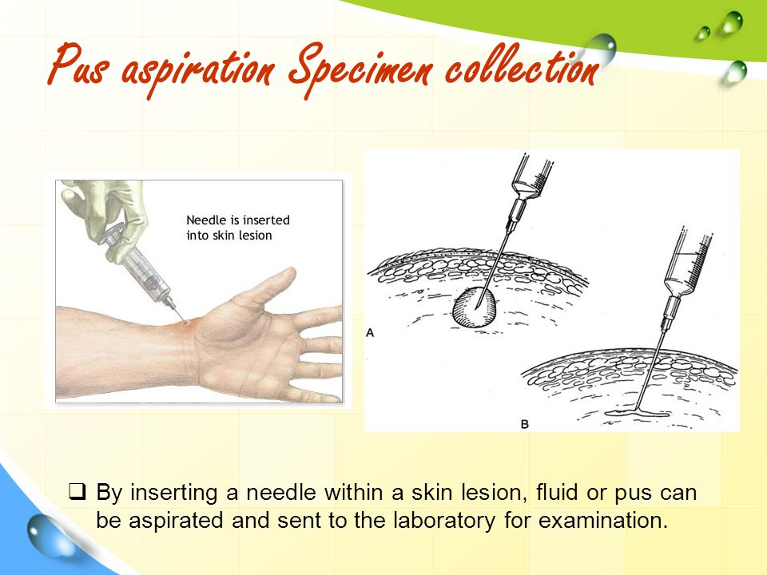

Slide 13
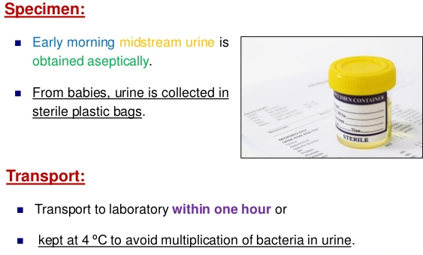
Clean-Catch Method For Urine
Catheter
It is a tubular instrument used for withdrawing and introducing fluids from or into the body cavity. Urine specimen may be collected with catheters to detect the urinary tract infection caused by bacteria in newborns.
Clean Catch Method
It is the most common method to collect used for collection of urine.
Optimum time is early morning
Midstream portion is collected .
For some patients, needle aspiration also are done directly into the urinary bladder.

Slide 14
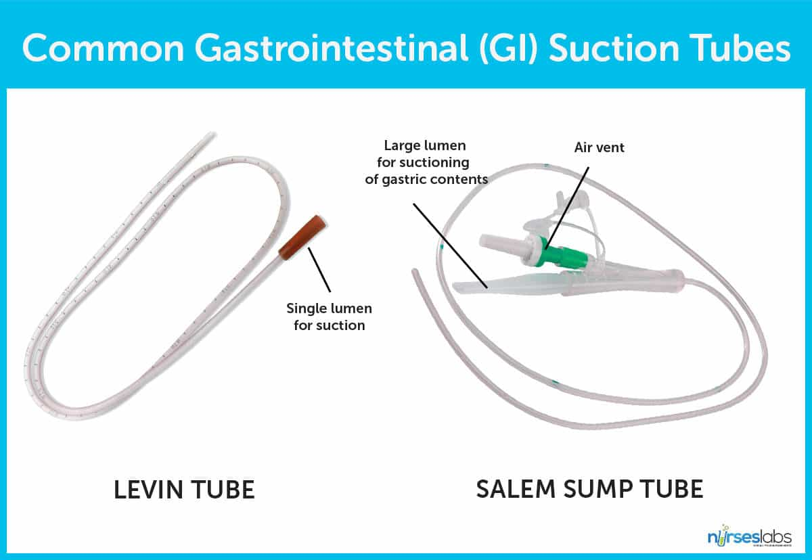
Intubation
Nasogastric intubation can be used to obtain a sample of stomach fluid.
The tube is passed through the nose rather than through the mouth.

Slide 15
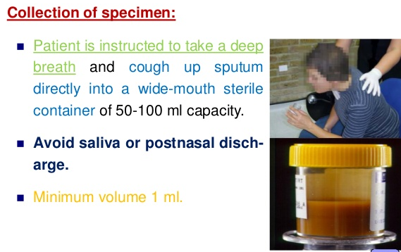
Sputum Cup Method
It is the most common specimen collection in suspected cases of lower respiratory tract infections.
Mucus secretion expectorated from the lungs, bronchi, trachia through the mouth & saliva. The patients to expectorate a clinical sample directly into the cup.

Slide 16
Stool
Collection of stool
Stools samples should be collected in clean leak-proof containers without disinfectant or detergent residue and with tight-fitting, leak-proof lids.
Unpreserved stool should be refrigerated, if possible, and processed within a maximum of 2 hours after collection.
Specimens that cannot be cultured within 2 hours of collection should be placed in transport medium and refrigerated immediately.
Routine culture of fecal specimen should include Salmonella, Shigella,and Campylobacter; specify Vibrio, Aeromonas, Plesiomonas, Yersinia, and Escherichia coli
Rejection of fecal Specimens
Stool specimens are unacceptable if any of the following conditions apply:
The information in the label does not match the information in the requisition
The specimen has not been transported in the proper medium
The quantity of specimen is insufficient for testing

Slide 17
Transport Media
Media appropriate for the transport of fecal specimens
Cary-Blair transport medium
High pH (8.4)
Medium of choice for transport and preservation of V. cholerae
Cary-Blair transport medium can be used to transport many bacterial enteric pathogens, including Shigella, Salmonella, and Vibrio cholerae
Staurt’s transport media
Acceptable for Shigella and Salmonella (including ser. Typhi), but they are inferior to Cary-Blair for transport of V. cholerae.
Salinite F broth: Salmonella
Alkaline peptone water
This medium may be used to transport V. cholerae, prevent the acidic contamination.
Buffered glycerol saline (BGS)
It’s a liquid medium which can be used for Shigella but this transport medium is unsuitable for transport of V. cholerae.

Slide 18
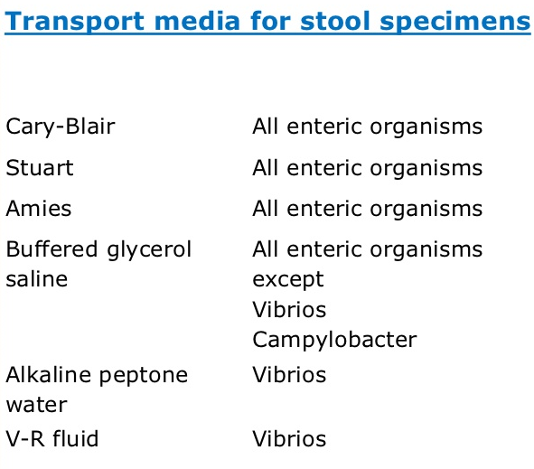

Slide 19
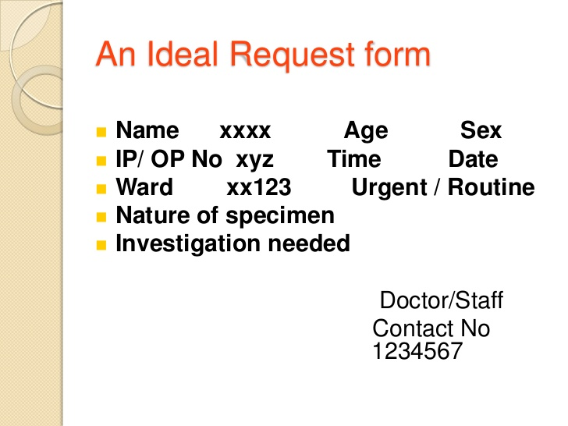
Handling of the Collected Samples
Immediately after Collection the specimen must be properly labeled and handled.

Slide 20


